Slide 1
Name : Hemant Pralhad Tikare
Email ID: hemanttikare2@gmail.com
Project 6: Bank Loan Case Study
This ppt is a exploration of Bank Loan Case Study based on analysis done on below points:-
1. Identify Missing Data and Deal with it Appropriately: Identify the missing data in the dataset and decide on an appropriate method to deal with it using Excel built-in functions and features.
2. Identify Outliers in the Dataset: Detect and identify outliers in the dataset using Excel statistical functions and features, focusing on numerical variables.
3. Analyze Data Imbalance: Determine if there is data imbalance in the loan application dataset and calculate the ratio of data imbalance using Excel functions.
4. Perform Univariate, Segmented Univariate, and Bivariate Analysis: This is one of the most important part of analysis to visualize the data.
5. Identify Top Correlations for Different Scenarios : Segment the dataset based on different scenarios (e.g., clients with payment difficulties and all other cases) and identify the top correlations for each segmented data using Excel functions.

Slide 2
Application Dataset - NULL values
Firstly the percentage of null values needs to be analyzed and those columns that have more than 50% of the null data have to be dropped And those columns with less than 50% of the null data have to be replaced with mean or median or the highest occurring categorical variables
Column Name | Total no. of Null values | % of null values
OWN_CAR_AGE | 32950 | 65.9
EXT_SOURCE_1 | 28172 | 56.344
APARTMENTS_AVG | 25385 | 50.77
BASEMENTAREA_AVG | 29199 | 58.398
YEARS_BUILD_AVG | 33239 | 66.478
COMMONAREA_AVG | 34960 | 69.92
ELEVATORS_AVG | 26651 | 53.302
ENTRANCES_AVG | 25195 | 50.39
FLOORSMIN_AVG | 33894 | 67.788
LANDAREA_AVG | 29721 | 59.442
LIVINGAPARTMENTS_AVG | 34226 | 68.452
LIVINGAREA_AVG | 25137 | 50.274
NONLIVINGAPARTMENTS_AVG | 34714 | 69.428
NONLIVINGAREA_AVG | 27572 | 55.144
APARTMENTS_MODE | 25385 | 50.77
BASEMENTAREA_MODE | 29199 | 58.398
YEARS_BUILD_MODE | 33239 | 66.478
COMMONAREA_MODE | 34960 | 69.92
ELEVATORS_MODE | 26651 | 53.302
ENTRANCES_MODE | 25195 | 50.39
FLOORSMIN_MODE | 33894 | 67.788
LANDAREA_MODE | 29721 | 59.442
LIVINGAPARTMENTS_MODE | 34226 | 68.452
LIVINGAREA_MODE | 25137 | 50.274
NONLIVINGAPARTMENTS_MODE | 34714 | 69.428
NONLIVINGAREA_MODE | 27572 | 55.144
APARTMENTS_MEDI | 25385 | 50.77
BASEMENTAREA_MEDI | 29199 | 58.398
YEARS_BUILD_MEDI | 33239 | 66.478
COMMONAREA_MEDI | 34960 | 69.92
ELEVATORS_MEDI | 26651 | 53.302
ENTRANCES_MEDI | 25195 | 50.39
FLOORSMIN_MEDI | 33894 | 67.788
LANDAREA_MEDI | 29721 | 59.442
LIVINGAPARTMENTS_MEDI | 34226 | 68.452
LIVINGAREA_MEDI | 25137 | 50.274
NONLIVINGAPARTMENTS_MEDI | 34714 | 69.428
NONLIVINGAREA_MEDI | 27572 | 55.144
FONDKAPREMONT_MODE | 34191 | 68.382
HOUSETYPE_MODE | 25075 | 50.15
WALLSMATERIAL_MODE | 25459 | 50.918

Slide 3
Application Dataset - NULL values
ALL THE COLUMN NAME MENTIONED BELOW NEED TO BE DROPPED DOWN
AS THEY ARE IRRELEVANT COLUMNS FOR DOING OUR ANALYSIS COLUMN
Column Name | Total no. of Null values | % of null values
FLAG_MOBIL | 0 | 0
FLAG_EMP_PHONE | 0 | 0
FLAG_WORK_PHONE | 0 | 0
FLAG_CONT_MOBILE | 0 | 0
FLAG_PHONE | 0 | 0
FLAG_EMAIL | 0 | 0
REGION_RATING_CLIENT | 0 | 0
REGION_RATING_CLIENT_W_CITY | 0 | 0
EXT_SOURCE_2 | 126 | 0.252
YEARS_BEGINEXPLUATATION_AVG | 24394 | 48.788
FLOORSMAX_AVG | 24875 | 49.75
YEARS_BEGINEXPLUATATION_MODE | 24394 | 48.788
FLOORSMAX_MODE | 24875 | 49.75
YEARS_BEGINEXPLUATATION_MEDI | 24394 | 48.788
FLOORSMAX_MEDI | 24875 | 49.75
TOTALAREA_MODE | 24148 | 48.296
EMERGENCYSTATE_MODE | 23698 | 47.396
DAYS_LAST_PHONE_CHANGE | 1 | 0.002
FLAG_DOCUMENT_2 | 0 | 0
FLAG_DOCUMENT_3 | 0 | 0
FLAG_DOCUMENT_4 | 0 | 0
FLAG_DOCUMENT_5 | 0 | 0
FLAG_DOCUMENT_6 | 0 | 0
FLAG_DOCUMENT_7 | 0 | 0
FLAG_DOCUMENT_8 | 0 | 0
FLAG_DOCUMENT_9 | 0 | 0
FLAG_DOCUMENT_10 | 0 | 0
FLAG_DOCUMENT_11 | 0 | 0
FLAG_DOCUMENT_12 | 0 | 0
FLAG_DOCUMENT_13 | 0 | 0
FLAG_DOCUMENT_14 | 0 | 0
FLAG_DOCUMENT_15 | 0 | 0
FLAG_DOCUMENT_16 | 0 | 0
FLAG_DOCUMENT_17 | 0 | 0
FLAG_DOCUMENT_18 | 0 | 0
FLAG_DOCUMENT_19 | 0 | 0
FLAG_DOCUMENT_20 | 0 | 0
FLAG_DOCUMENT_21 | 0 | 0

Slide 4
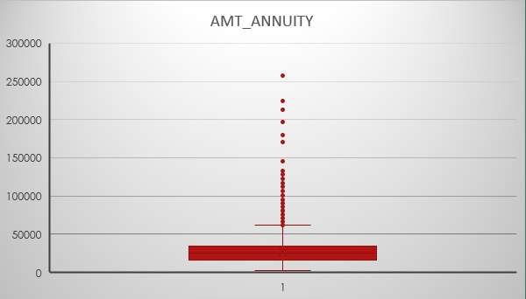
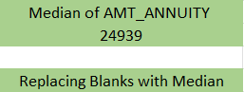
Application Dataset – Replacing blanks
Replacing Blanks in AMT_ANNUTIY column of the Application Dataset with the median of the AMT_ANNUITY as there exists outliers in the AMT_ANNUITY column

Slide 5
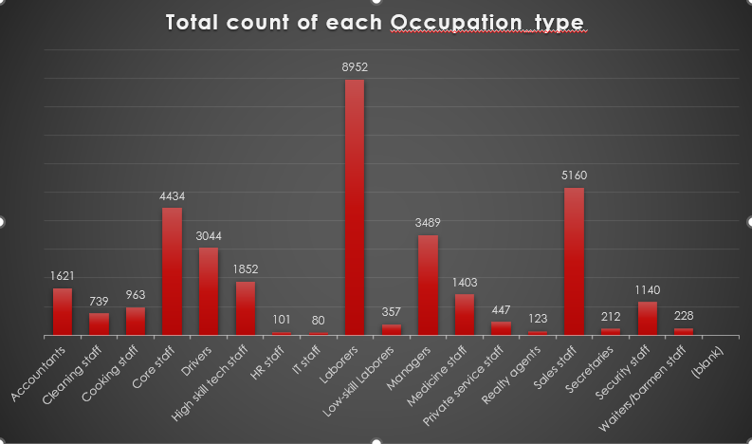
Application Dataset – Replacing blanks
Replacing Blanks in Occupation_Type column of the Application Dataset with the highest occurring categorical variable
Row Labels | Count of OCCUPATION_TYPE
Accountants | 1621
Cleaning staff | 739
Cooking staff | 963
Core staff | 4434
Drivers | 3044
High skill tech staff | 1852
HR staff | 101
IT staff | 80
Laborers | 8952
Low-skill Laborers | 357
Managers | 3489
Medicine staff | 1403
Private service staff | 447
Realty agents | 123
Sales staff | 5160
Secretaries | 212
Security staff | 1140
Waiters/barmen staff | 228
(blank)
Grand Total | 34345
Highest occurring categorical variable is ‘Laborers’

Slide 6
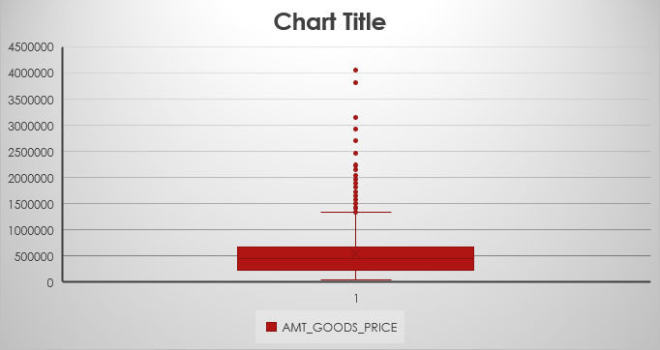
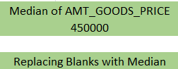
Application Dataset – Replacing blanks
Replacing Blanks in AMT_GOODS_PRICE column of the Application Dataset with the median of the AMT_GOODS_PRICE as there exists outliers in the AMT_GOODS_PRICE column

Slide 7
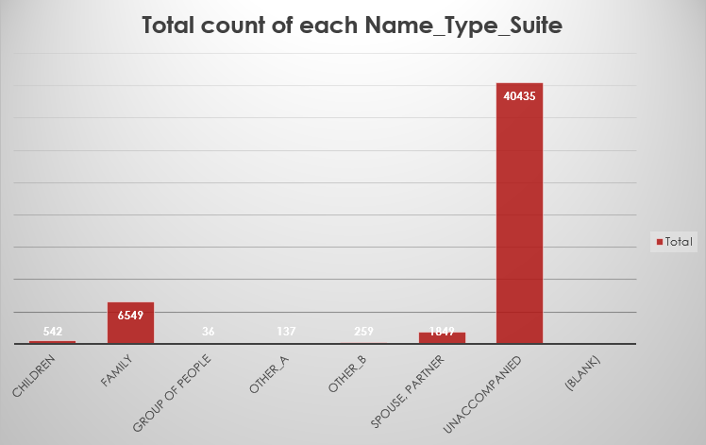
Application Dataset – Replacing blanks
Replacing Blanks in Name_Type_Suite column of the Application Dataset with the highest occurring categorical variable
Row Labels | Count of NAME_TYPE_SUITE
Children | 542
Family | 6549
Group of people | 36
Other_A | 137
Other_B | 259
Spouse, partner | 1849
Unaccompanied | 40435
(blank)
Grand Total | 49807
Highest occurring categorical variable is ‘Unaccompanied’

Slide 8
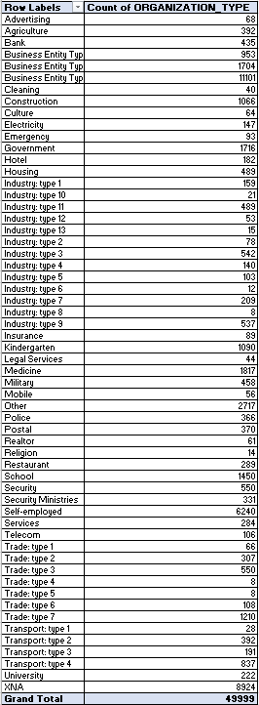
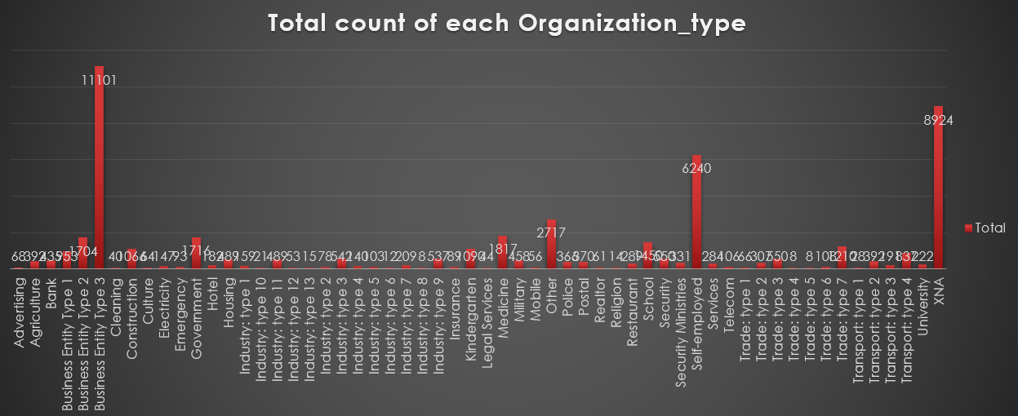
Departmental Analysis
Replacing Blanks in Organization_type column of the Application Dataset with the highest occurring categorical variable
Highest occurring categorical variable is Business Entity Type 3’

Slide 9
Application Dataset – Replacing blanks
First outlier is in AMT_ANNUITY
which is greater than 250000
this outlier is replaced with 24903
median of AMT_ANNUITY

Slide 10
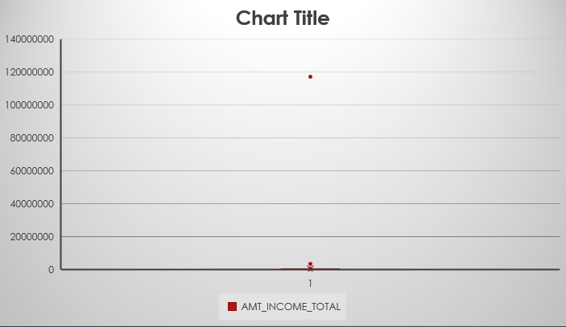
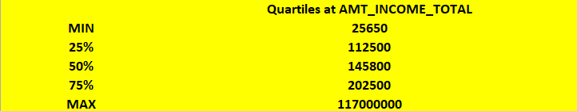
Application Dataset - Outliers
Here we can observe that there is huge difference between the 25%, 50% and 75% quartile and this is due to presence of outliers But since the amount of total income varies from person to person we will not remove the outliers

Slide 11
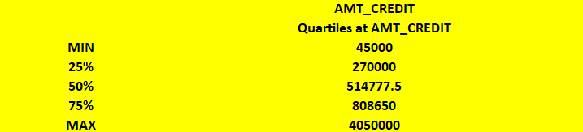
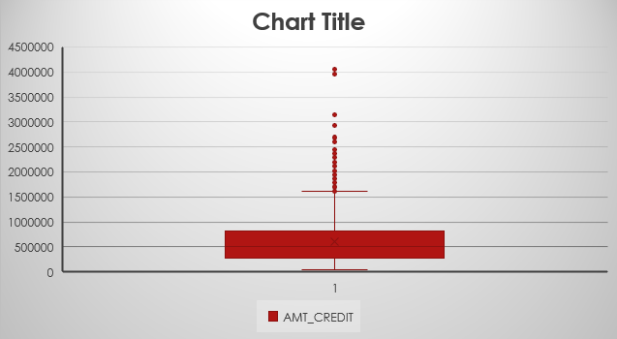
Application Dataset - Outliers
From the chart it is clear that outliers lie in the 98% and near max side of the box plot Also there is a significant difference between the 75% quartile and the max value and this is due the presence of the outliers
But since the amount of credit varies from person to person we will not remove the outliers

Slide 12

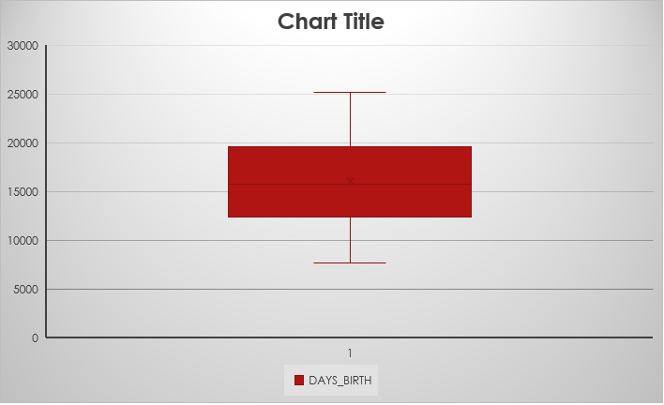
Application Dataset - Outliers
As seen from the boxplot it is clear that there are no outliers
The data of DAYS_BIRTH is well distributed

Slide 13
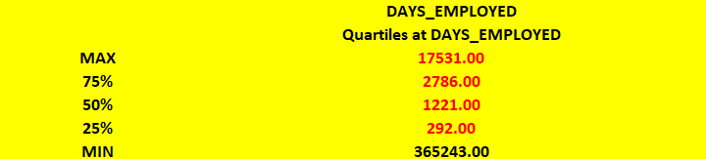
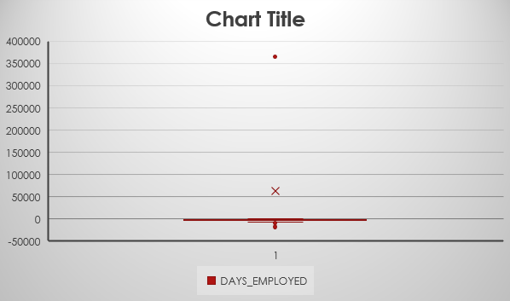
Application Dataset - Outliers
There exists only 1 outlier i.e. + or
365243
Replace with median
1213.00

Slide 14
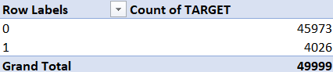
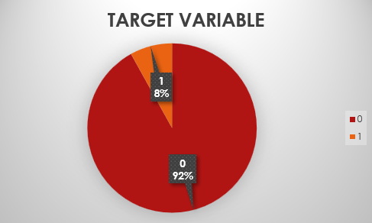
Application Dataset - Analysis
The Target Variable Pie chart
shows that almost 92%
of the total clients had
no problem during payment
while 8% of the clients
had some or the other problem
0 No payment issues
1 Had some payment issues

Slide 15
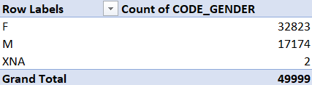
Application Dataset - Analysis
From the GENDER_VARIABLE pie chart
we can infer that almost 66% of
the clients are female and 34% of the
clients are Male
The 2 of the applicants have gender as XNA
which can be ignored

Slide 16
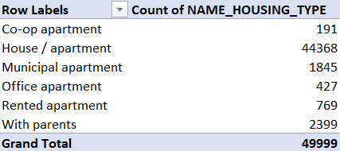
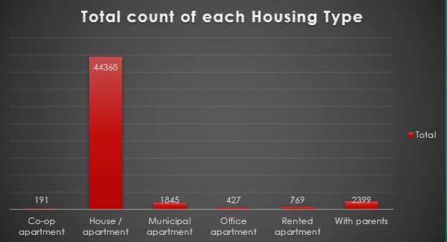
Application Dataset - Analysis

Slide 17
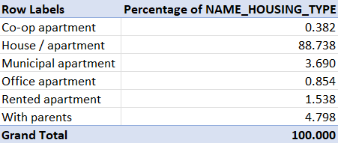
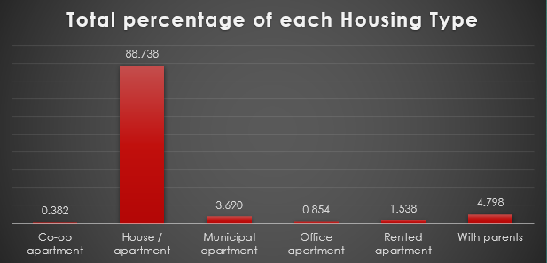
Application Dataset – Analysis
NAME_HOUSING_TYPE
From the bar graphs of count and percentage the bank can target those groups who do not have their own apartment i.e. the bank may consider the People living in Co op apartment, Municipal Apartment,
Rented Apartment and people living with their parents

Slide 18
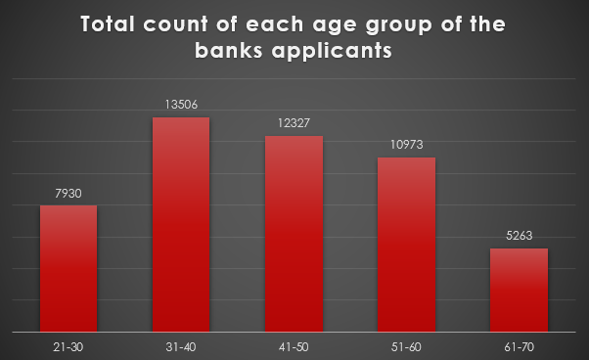
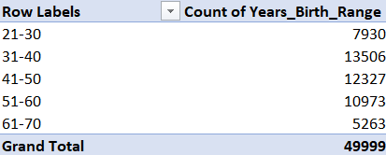
Application Dataset – Analysis
Univariate Analysis
AGE GROUP
From the adjacent bar plot we can infer that most of the applicants belong to the Age Group ’31-40’

Slide 19
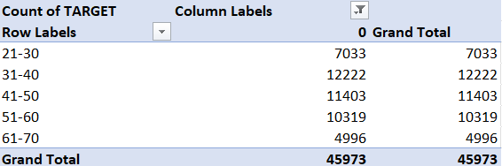
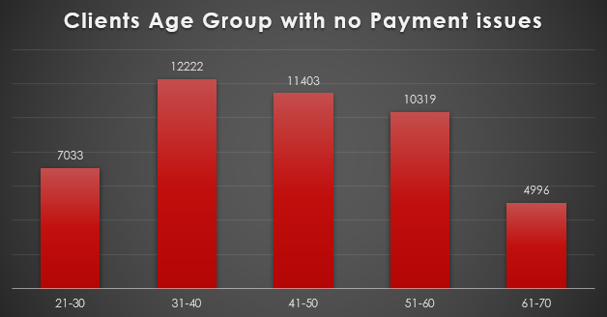
Application Dataset – Analysis
Univariate Analysis
AGE GROUP
From the adjacent Bar plot we can infer that clients/applicants in the Age Group ’31-40’ are having the highest number when it comes to doing/returning Payment to Banks

Slide 20
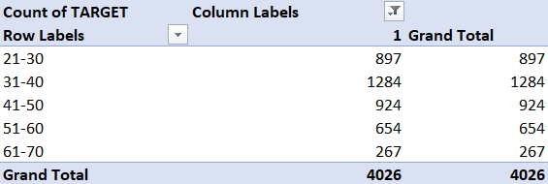
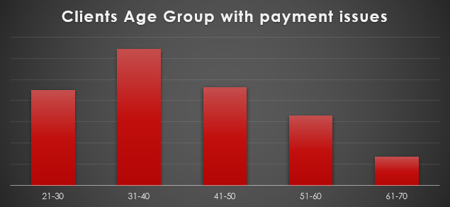
Application Dataset – Analysis
Univariate Analysis
AGE GROUP
From the adjacent Bar plot we can infer that clients/applicants in the Age Group ’31-40’ are having the highest number when it comes to doing/returning Payment to Banks

Slide 21
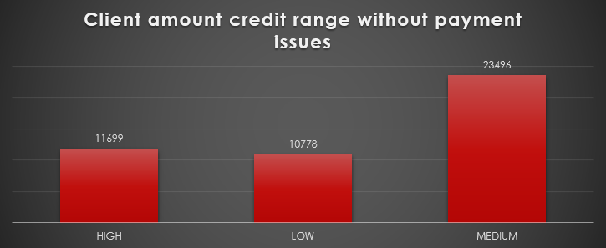
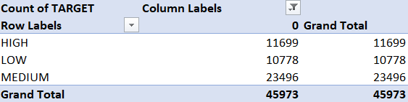
Application Dataset – Analysis
Univariate Analysis
Client amount credit range
From the adjacent Bar plot we can infer that clients belonging to ‘Medium’ income range have the highest count when it comes to clients with no payment issues

Slide 22
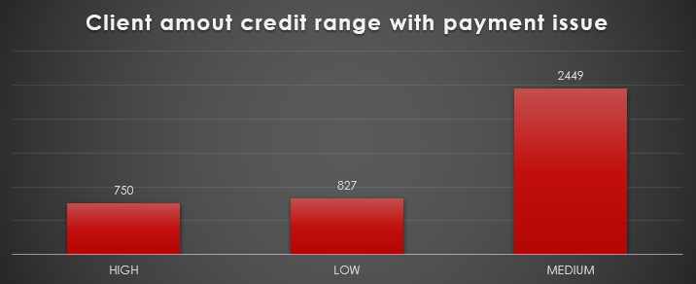
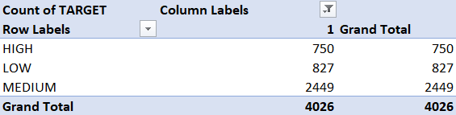
Application Dataset – Analysis
Univariate Analysis
Client amount credit range
From the adjacent Bar plot we can
infer that clients belonging to
‘Medium’ income range have the
highest count when it comes to
clients with payment issues

Slide 23
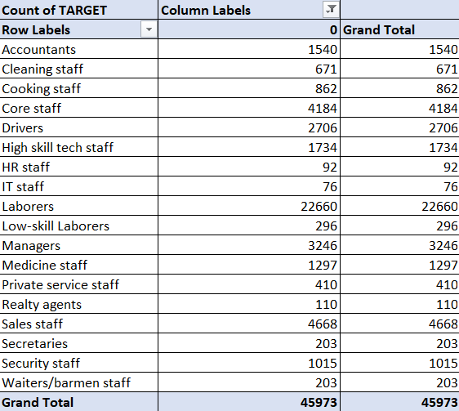
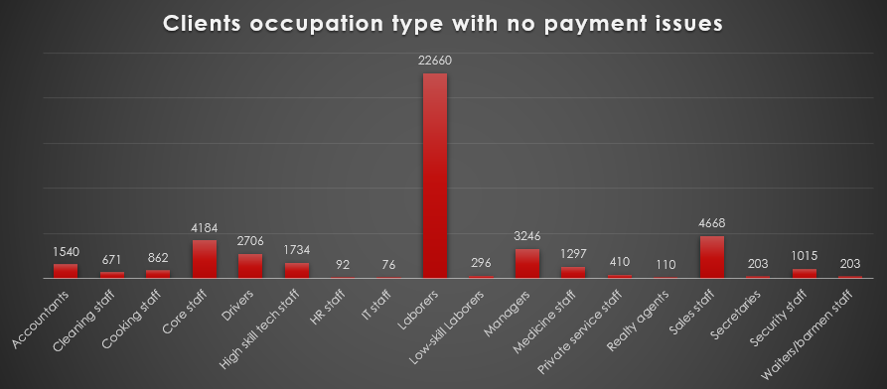
Application Dataset – Analysis
Univariate Analysis
OCCUPATION_TYPE
From the above bar plot we can infer that clients with occupation_type ‘Laborers’ have the highest number of count when it comes to clients with no payment issues

Slide 24
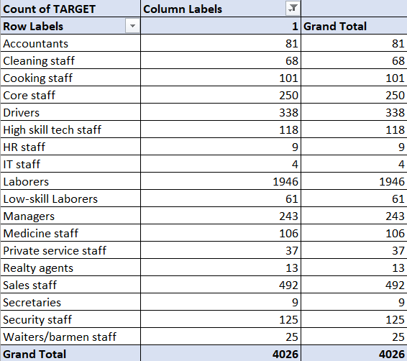
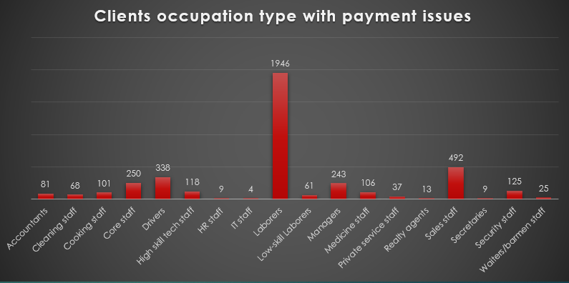
Application Dataset – Analysis
Univariate Analysis
OCCUPATION_TYPE
From the above bar plot we can infer that clients with occupation_type ‘Laborers’ have the highest number of count when it comes to clients with payment issues

Slide 25
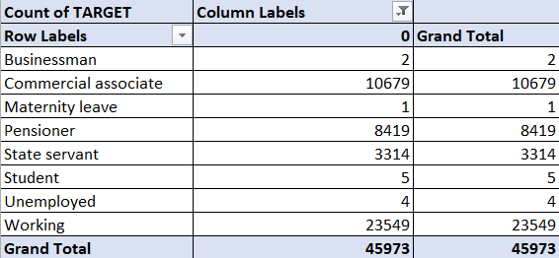
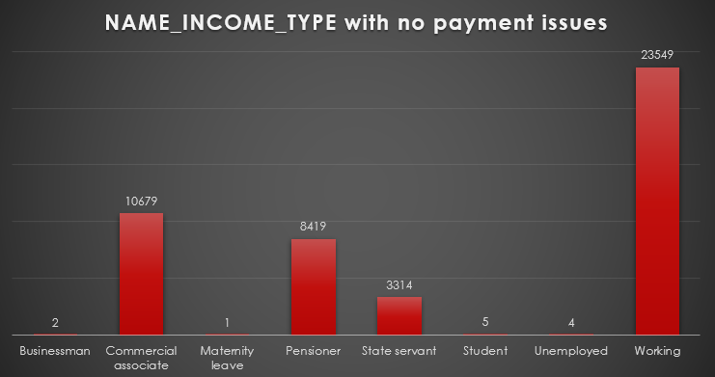
Application Dataset – Analysis
Univariate Analysis
NAME_INCOME_TYPE
From the above Bar plot we can infer that clients having income_type as ‘WORKING’ have the
highest count when it comes to clients with no payment issues

Slide 26
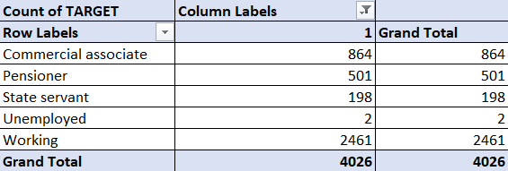
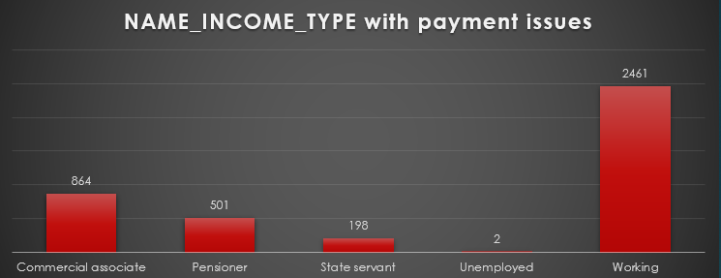
Application Dataset – Analysis
Univariate Analysis
NAME_INCOME_TYPE
From the above Bar plot we can infer that clients having income_type as ‘WORKING’ have the
highest count when it comes to clients with payment issues

Slide 27
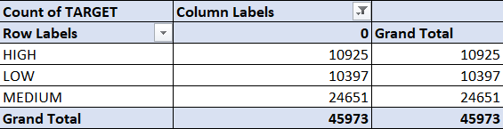
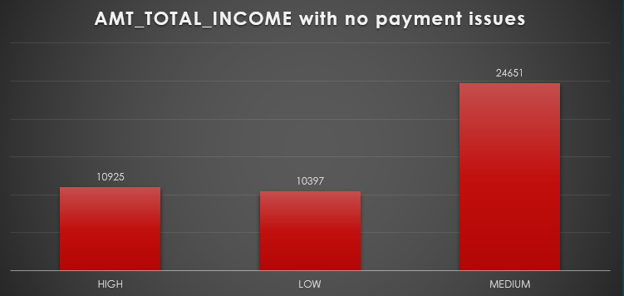
Application Dataset – Analysis
Univariate Analysis
AMT_TOTAL INCOME
From the above Bar plot we can infer that client having the total income range as ‘Medium’
have the highest count when it comes to clients having no payment issues

Slide 28
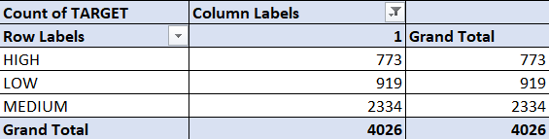
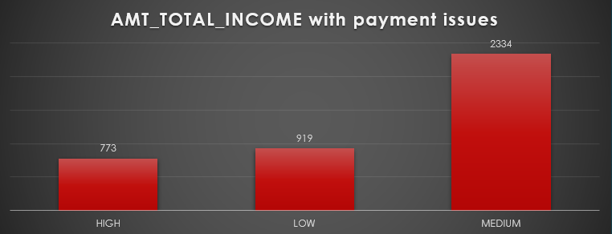
Application Dataset – Analysis
Univariate Analysis
AMT_TOTAL INCOME
From the above Bar plot we can infer that client having the total income range as ‘Medium’
have the highest count when it comes to clients having payment issues

Slide 29
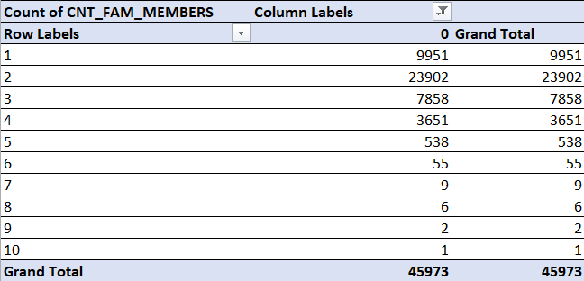
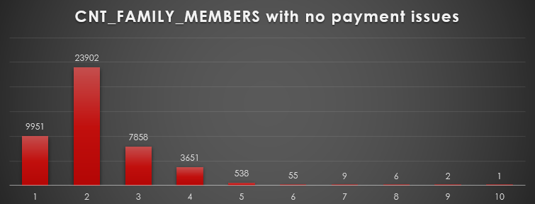
Application Dataset – Analysis
Univariate Analysis
CNT_FAMILY_MEMBERS
From the above Bar plot we can infer that clients having total count of family members as 2 have the highest count when it comes to clients having no payment issues

Slide 30
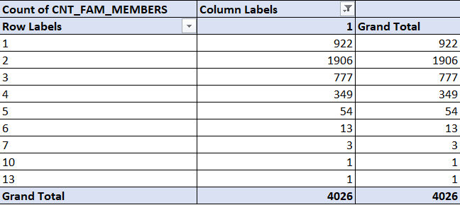
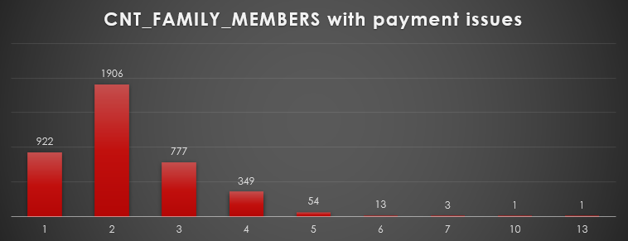
Application Dataset – Analysis
Univariate Analysis
CNT_FAMILY_MEMBERS
From the above Bar plot we can infer that clients having total count of family members as 2 have the highest count when it comes to clients having payment issues.

Slide 31
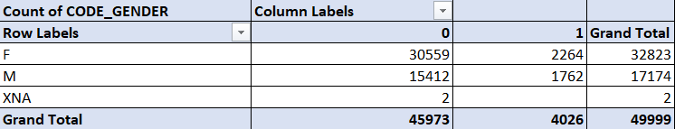
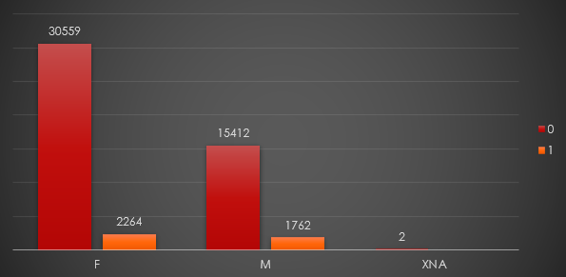
Application Dataset – Analysis
Univariate Analysis
CODE_GENDER
From the above Bar Plot we can infer that Clients with CODE_GENDER = ‘F’ have the highest
number of non defaulters i.e. 30559 – 2264 = 28,295

Slide 32


Application Dataset – Analysis
Univariate Analysis
NAME_INCOME_TYPE
From the adjacent Bar Plot we can infer that clients having NAME_INCOME_TYPE = ‘WORKING’ having the highest count of Non defaulters i.e. 23549 – 2461 = 21088

Slide 33


Application Dataset – Analysis
Univariate Analysis
NAME_EDUCATION_TYPE
From the above Bar Plot we can infer that clients having NAME_EDUCATION_TYPE = ‘SECONDARY/SECONDARY SPECIAL’ have the highest count for Non defaulters i.e. 32363 – 3209 = 29154

Slide 34

Application Dataset – Analysis
Univariate Analysis
NAME_FAMILY_STATUS
From the adjacent Bar Plot we can infer that clients having NAME_FAMILY_STATUS = ‘MARRIED’ have the highest count of Non defaulters i.e. 29699 – 2395 = 27304

Slide 35


Application Dataset – Analysis
Univariate Analysis
NAME_HOUSING_TYPE
From the above Bar Plot we can infer that clients having NAME_HOUSING_TYPE = ‘House/Apartment’ have the highest count of Non defaulters i.e. 40895 – 3473 = 37422

Slide 36


Application Dataset – Analysis
Univariate Analysis
OCCUPATION_TYPE
From the adjacent Bar plot we can infer that clients having occupation_type = ‘Laborers’ have the highest count for Non defaulters i.e. 22660 – 1946 = 20714

Slide 37


Application Dataset – Analysis
Bivariate Analysis for TARGET variable
Target 0: Total_income_range vs Code_gender
From the above Bar plot we can infer that Females belonging to Medium income group are the highest number of clients with no payment issues

Slide 38


Application Dataset – Analysis
Bivariate Analysis for TARGET variable
Target 1: Total_income_range vs Code_gender
From the above Bar plot we can infer that Females belonging to Medium income group are the highest number of clients with payment issues

Slide 39


Application Dataset – Analysis
Bivariate Analysis for TARGET variable
Target 0: Credit Amt vs Education status
From the adjacent Bar Plot we can infer that clients having credit amt range as ‘Medium’ and education status as ‘Secondary/ Secondary Special’ have the highest count for clients with no payment issues

Slide 40


Application Dataset – Analysis
Bivariate Analysis for TARGET variable
Target 1: Credit Amt vs Education status
From the adjacent Bar Plot we can infer that clients having credit amt range as ‘Medium’ and education status as ‘Secondary/Secondary Special’ have the highest count for clients with payment issues

Slide 41


Application Dataset – Analysis
Bivariate Analysis for TARGET variable
Target 0: Total Income vs Family status
From the adjacent Bar plot we can infer that clients with total_income_range as ‘Medium’ and family_status as ‘Married’ have the highest count for clients having no payment issues

Slide 42


Application Dataset – Analysis
Bivariate Analysis for TARGET variable
Target 1: Total Income vs Family status
From the adjacent Bar plot we can infer that clients with total_income_range as ‘Medium’ and family_status as ‘Married’ have the highest count for clients having payment issues.

Slide 43


Application Dataset – Analysis
Top Correlation between variable and Target variable

Slide 44

Previous Application Dataset - NULL values
The following columns of the previous application datasets need to be dropped as
they are irrelevant for doing the data analysis

Slide 45


Previous Application Dataset - NULL values
Replace Blanks with ‘Unaccompained’

Slide 46




Previous Application Dataset - Analysis

Slide 47




Previous Application Dataset - Analysis

Slide 48




Previous Application Dataset - Analysis

Slide 49




Previous Application Dataset - Analysis

Slide 50
Conclusions
Hence the analysis are being done on both datasets Applications Dataset and Precious Applications Dataset
The following conclusions were drawn from the analysis done
•The proportion/percentage of the defaulters(target = 1) is around 8% and that of non defaulters(target = 0) is around 92%
•The Bank generally lends more loan to Female clients as compared to Males clients as the count of Female clients in the defaulter’s list is less than that of Males. Still Bank can look for more Male clients if their credit amount is satisfied
•Also the clients who belong to Working class tend to pay their loans on time followed by the clients who fall under Commercial Associate
•Clients having Education status like Secondary/ Higher Secondary or more tend to pay loan on time so bank can prefer lending loans to clients having such Education Status
•Clients who fall in the Age Group 31-40 have the highest count for paying off their loans on time followed by the clients who fall in the Age Groups 41-60
•Clients having MEDIUM credit amount range tend to pay off their loans on time than compared to HIGH and LOW credit range

Slide 51
Conclusions
• Clients living in House/Apartment tend to pay off their loans quickly as compared to other housing type. So Bank can lend loan to clients having housing type -> House/Apartment
• Clients having occupation_type= Laborers tend to pay their loans on time and hence Bank should prefer clients having such background
Google Drive Link for Excel sheet of Analysis of Cleaned Data done:
Application data cleaned
previous data cleaned

